Slide 1
Office 365 Development

Slide 2
Deep dive into the Office 365 File Handler Extensibility

Slide 3















Vision
EXTEND OFFICE EVERYWHERE
CONNECT TO OFFICE 365 SERVICES
BUILD USING AN OPEN PLATFORM
Delve
z
Users and groups
Files
Mail
Calendar
My Apps
Video Portal
Contacts
Office Graph
Presentations
Documents
Spreadsheets
Lync
OneNote
Yammer

Slide 4

Agenda
Introducing File Handlers
Developing File Handlers
Acquiring File Handlers

Slide 5
Introducing File Handlers

Slide 6
File Handlers for SharePoint Online
Extend preview & open support for non-standard file types in SharePoint Online document libraries
Developers have full control over preview & open experiences
Ideal for proprietary file types not supported by SharePoint
Ideal for “link” or pointer file

Slide 7
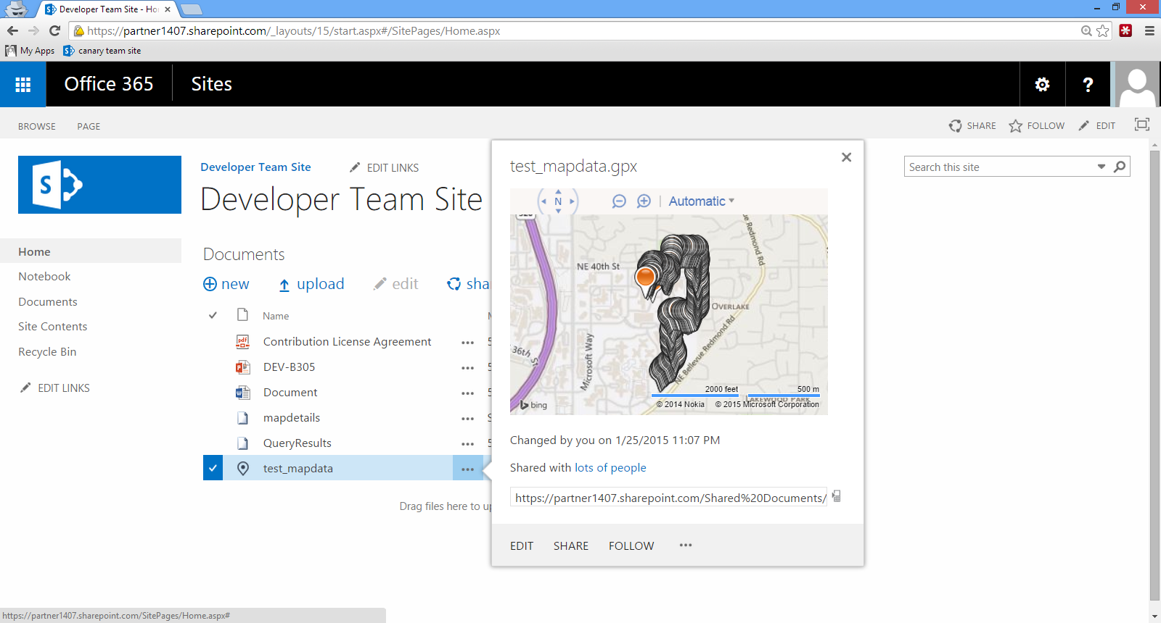
Preview & Open Proprietary File Types
Request corrections

Slide 8
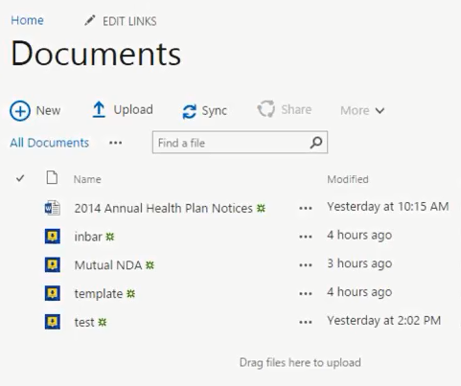
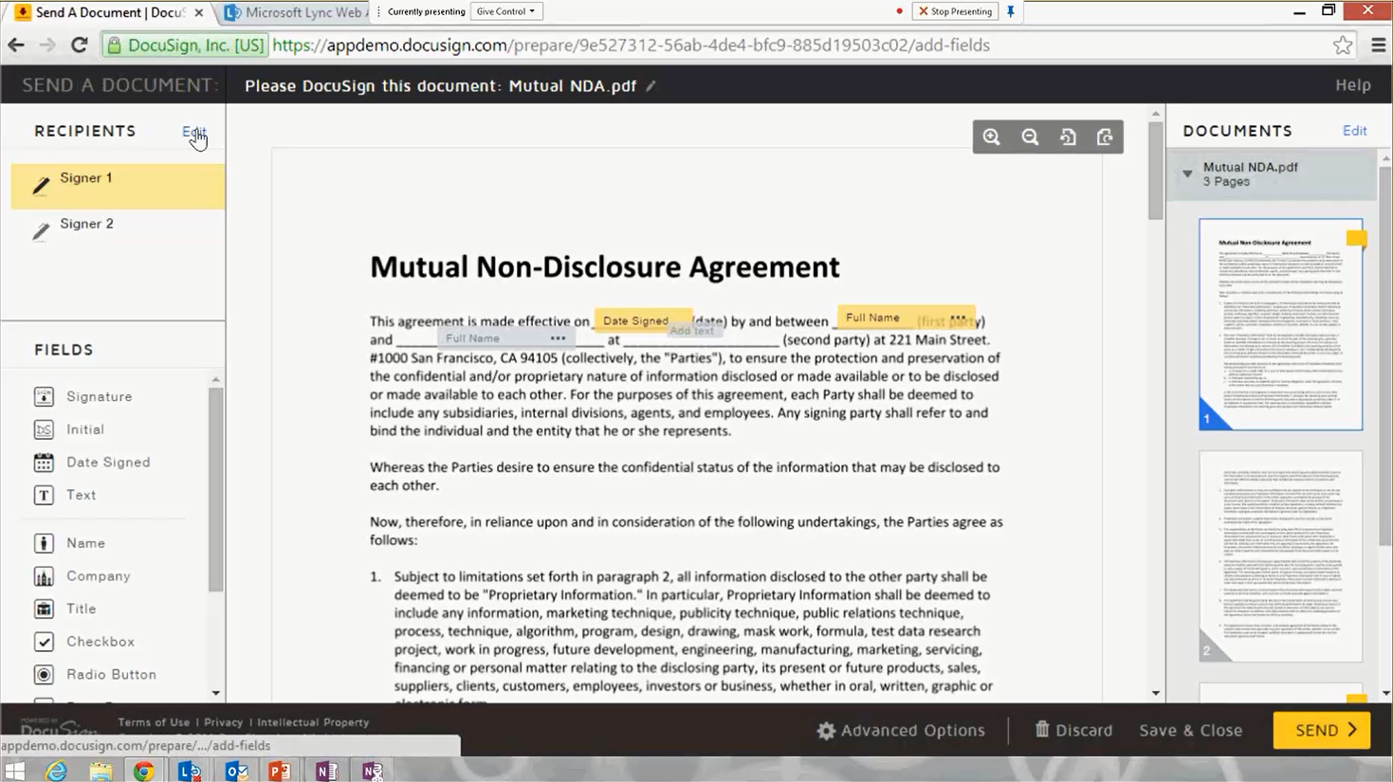
Integrate Processes Through File Pointers

Slide 9
demo
Viewing File Handlers

Slide 10
Creating File Handlers

Slide 11
File Hander Creation Process
Registering app in Azure AD
Creating and deploying application resources
Associating add-in metadata with AAD app
Ensuring proper behavior at runtime
Declaring add-in metadata

Slide 12



Specifying App Type for File Handler Distribution
Single-tenant (LoB) apps are created for a single organization to customize business processes.
Multi-tenant (SaaS) apps can be consented to by many tenants for wide distribution.

Slide 13
Scopes Required for File Handlers
Windows Azure Active Directory
Scope: Enable sign-on and read users’ profiles.
Office 365 Unified API
Scope: Read (and write) files that the user selects.

Slide 14
Specifying File Handler Behaviors
Required Properties
Extension: The file type to target with the add-in.
Ex: png, pdf, txt
Optional Properties
OpenUrl: The endpoint for editing a file.
Ex: https://app.com/filehandler/open
PreviewUrl: The endpoint that displays a file preview.
Ex: https://app.com/filehandler/preview
FileIcon: The image representing the file in Office.
Ex: https://app.com/filehandler/icon.png

Slide 15
Add-In Metadata in AAD Application Object
{
'addIns':[
{
'id':'95B0CE75-F0B9-4758-9F8F-0124C2B0B3B0',
'type':'FileHandler',
'properties':[
{
'key':'extension',
'value':’blog'
}, {
'key':'fileIcon',
'value':'https://[..].azurewebsites.net/content/rss.png'
}, {
'key':'openUrl',
'value':'https://[..].azurewebsites.net/FileHandler/Open'
}, {
'key':'previewUrl',
'value':'https://[..].azurewebsites.net/FileHandler/Preview'
}
]
}
]
}

Slide 16
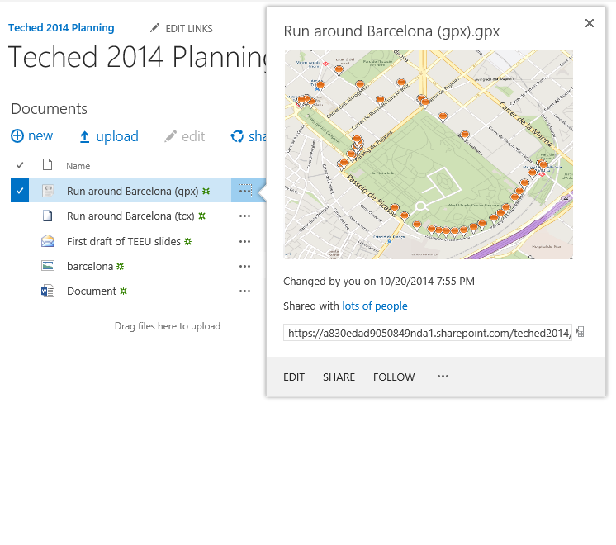


Extensions at Runtime
From a document library, the user clicks the file’s … button
SharePoint POSTs activation parameters to the app’s preview URL
If the app has no cached AAD access token, obtain one
The app gets file data using the AAD token + FileGET activation parameter
The app generates a preview of the page using the file’s stream
The user is able to preview a file inline
5
2
1
App
4
6
3
Azure AD

Slide 17
Activation Parameters
Provides context at runtime via POST form data.
File Handler Activation Parameter | Description
FileGet | URL to call to get the file opened/previewed
FilePut | URL that persists file back to its original location
Client | Office client file is previewed/opened from
CultureName | Culture name of the tenant
ResourceId | URL of the tenant used for AAD authentication process
FileId | Unique GUID that identifies the file.

Slide 18
demo
Creating File Handlers

Slide 19
Managing & Acquiring File Handlers

Slide 20
Add-In Consent
Completing common consent writes add-in metadata to your tenant – no additional installation steps needed
Office reads this data from AAD when loading documents/attachments. Removing the app from your tenancy removes the file handler from your UI

Slide 21
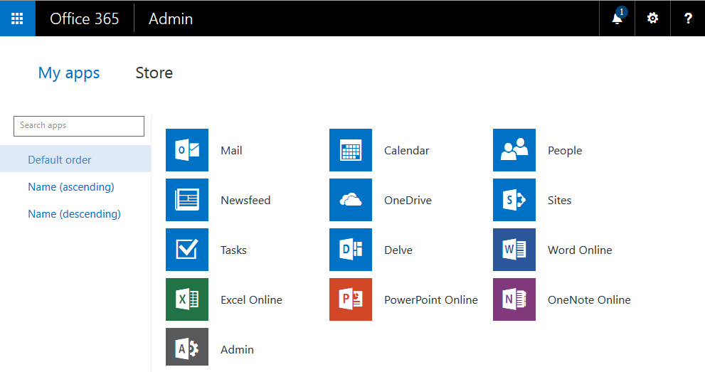
Acquiring File Handlers from the Store
Find file handlers from directly within the app launcher

Slide 22
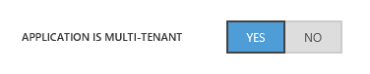
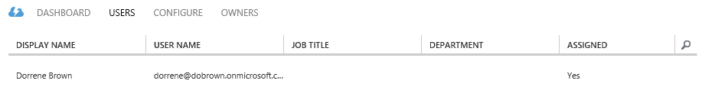
Assigning File Handlers to Users within AAD
Management features in the Azure management portal allow admins to grant selective access to apps.

Slide 23
demo
DEMO DESCRIPTION

Slide 24
Summary
Introducing File Handlers
Developing File Handlers
Acquiring File Handlers

Slide 25



dev.office.com
Sign up
http://dev.office.com/getting-started
Explore
http://apisandbox.msdn.microsoft.com
Get trained http://dev.office.com/training

Slide 26


Feedback
Office 365 Network Share you best practices and join conversations https://www.yammer.com/itpronetwork
Stackoverflow Ask deep technical questions to a world-wide set of developers
http://stackoverflow.com/questions/tagged/ms-office
UserVoice Provide suggestions of what you want in future versions
http://officespdev.uservoice.com/

